Slide 2
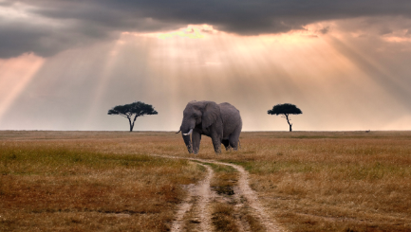
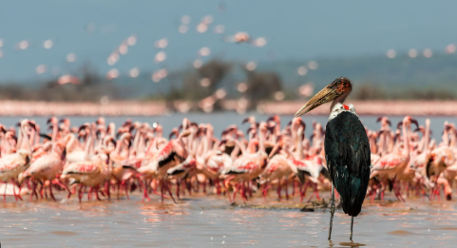
Masai Mara 6N,7 Days

Slide 3
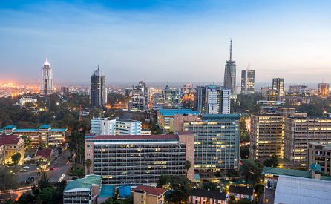
Day 1: Arrival in Nairobi •Activity: Arrive at JKIA, meet for a pre-safari briefing. •Transfer: Private transfer to your hotel for overnight stay. •Hotel: Ibis Hotel •Meals: Breakfast Only (BB) •Distance: 20.5 km (12.6 miles) •Drive Time: Approximately 30 minutes

Slide 4
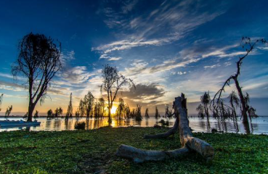
Day 2: Lake Nakuru Activity: After breakfast, depart for Lake Nakuru National Park. Arrive for check in, lunch, afternoon game drive, dinner and overnight at Sarova Lion Hill Game Lodge. (BLD) •Hotel: Sarova Lion Hill Game Lodge. (BLD) •Meals: Breakfast, Lunch, Dinner (BLD) •Distance: 156.9 km (97.1 miles) •Drive Time: Approximately 3 hour and 18 minutes

Slide 5
Day 3: Lake Nakuru – Lake Naivasha • Activity: 06:00hrs Early Morning, 09:00hrs After breakfast, depart enroute with a game drive to Lake Naivasha. dinner and overnight at LNCC. •Meals: Breakfast, Lunch, Dinner (BLD) •Distance: 70.9 km (43.9 miles) •Drive Time: Approximately 1 hour and 29 minutes

Slide 6
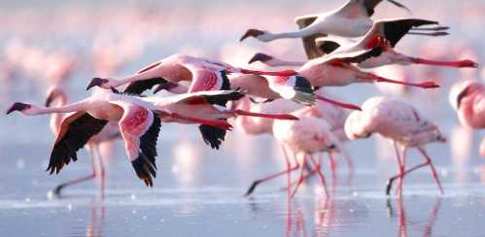
Day 4: Masai Mara National Reserve • Activity: After breakfast, depart for Masai Mara National Reserve. Check-in, lunch, afternoon game drive. •Hotel: Keekorok Lodge •Meals: Breakfast, Lunch, Dinner (BLD) •Distance: 210 km (130 miles) •Drive Time: Approximately 3 hours and 26 minutes
•

Slide 7
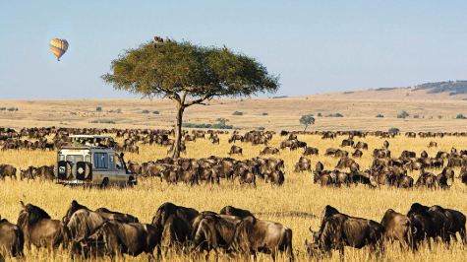
Day 5 and 6: Masai Mara Game Drive • Activity: After breakfast, depart with picnic lunch for a full-day game drive around the Mara circuit OR morning and afternoon game drive. •Hotel: Keekorok Lodge •Meals: Breakfast, Lunch, Dinner (BLD) •Distance: 100 km (62 miles) •Drive Time: 2 to 5 hours (depending on game drive itinerary)
•

Slide 8
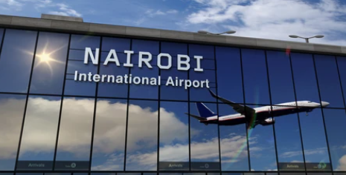
Day 7: Return to Nairobi • Activity: After breakfast, depart for Nairobi and arrive in time for lunch. •Meals: Breakfast Only (BB) •Distance: 228 km (141 miles) •Drive Time: Approximately 4 hours and 13 minutes

Slide 9
BELOW RATES APPLICABLE FOR 20 PAX
 | Peak | Off Peak
PER PERSON COST | USD 2999 + 5% GST | USD 1550 + 5% GST
MEALS:AP
VEHICLE:JEEP/VAN(AS PER AVAILABILITY)
CHILD BETWEEN 6-10 YEARS WILL CHARGES 50%
ESSENTIALS:
Basic personal items to be carried include, feather jacket & heavy woolens duringwinter and light woolens during summer, walking boots, rain proof jackets during monsoon, torch, spare batteries, water-flask, cold cream, personal medicines & Sunglasses. Guests are advised to bring heavy woolen clothes

Slide 10
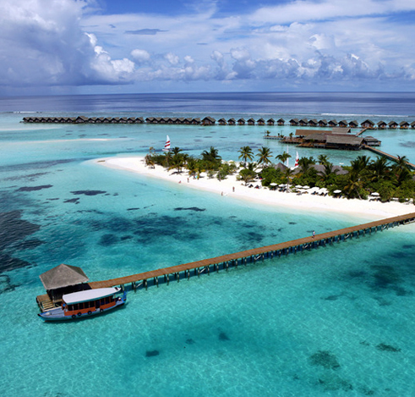
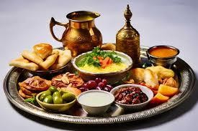
TERMS & CONDITIONS
INCLUSIONS:
Accommodation as detailed in the itinerary or similar.
Private transportation in a chauffeur-driven 4WD Safari Land Cruiser with pop-up roof for easy game viewing & photography.
Services of an experienced English-speaking driver-guide.
Game viewing drives as indicated.
All government taxes, park entrance fees, and levies.
All meet and greet services.
Arrival and departure transfers.
All meals as indicated in the itinerary.
1 liter of bottled drinking water per person per day while on safari.
EXCLUSIONS:
5% GST not included with this package
1.Items of personal nature e.g., laundry, telephone calls, etc.
2.Tips and gratuities to hotel/lodge staff and driver-guides.
3.All alcoholic and non-alcoholic drinks not specified.
4.Optional activities and any item not included in the itinerary.
5.Flying doctors’ coverage: Optional at US$50 per person for 14 days. Recommended personal insurance coverage.
•

Slide 11
PAYMENT:
40% of the total package amount has to be done in advance to confirm the package. Bookings will not be processed without advance payment. Rest of the payment must be cleared at the time of arrival, either in our office or our representatives will be there at the NJP Rly Station/ Bagdogra Airport to collect the payment. Only cash/Demand draft drawn in the favor of HODOPHILIA.HOLIDAYS will be accepted. Cheques will not be acceptable. In case the payment is done through credit card 3% extra is chargeable. Kindly share your arrival details such as train /flight no etc. so that we can plan your schedule accordingly.
ABOUT TRANSPORT:
In this sector the same vehicles will not be provided for the entire tour, it will be changed sector-wise. So, we request you to avoid any circumstances. If any tourist spot is not covered which falls on closing day & if you want to do the same next day then you have to pay the extra cost for the vehicle. Kindly maintain the timing for the sightseeing’s / transfers which will be advisable by our executive.
PACKAGE POLICY:
The above itinerary is a suggested Tour Plan. The Company is responsible for only those services which are charged from the guest. All other services which are not paid by the guest to the Company are Suggested services and Company is nowhere bound to provide that service or pay the cost for the same. Check-in and Check-out timing of the Hotels will be according to the timing of the respective Hotels. Company is not responsible for compensating any loss or additional cost incurred by the guest while taking the tour. Company is not responsible nor liable for any damage, loss or injury caused to any passenger while taking the tour. Any Claim related to the Package must be brought to the notice of the Company within a week.
TERMS & CONDITIONS:
No refund will be made for any unused accommodation, missed meals, transportation segments, sightseeing tours or any other service. Such unused items are neither refundable nor exchangeable. Room allocation is done by the hotel depending upon the availability at the time of check-in in the category of room as specified on your confirmation voucher. No refund shall be claimed, if the services & amenities of hotels are not up to your expectations. Any cost arising due to the natural calamities like landslides, road blockage, political disturbances (strikes) etc. is to be borne by you which is directly payable on the spot.

Slide 12
AMENDMENT:
Amendment of the booked tour will be treated as Cancellation. However, minor amendments can be made on the payment of a communication charge, which will vary from case to case.
REFUND:
Refunds will be paid to the source through which the guest has booked. Any refund will take at least 15 days to process & will be sent to you by A/c Payee Cheque only.
** NO REFUND WILL BE MADE AGAINST ANY UNUTILIZED SERVICES, WHAT SO EVER MAY BE THE REASONS.
CANCELLATION POLICY:
Cancellation has to be sent to us by Mail/Fax.
From The Date of Booking: 40% Of Tour Cost Will Be Charged as Cancellation Fees.
30-15 Days Prior To Departure: 60% Of Tour Cost Will Be Charged as Cancellation Fees. 14-01 Days
Prior To Departure: 100% Of Tour Cost Will Be Charged as Cancellation Fees.
In case of any unforeseen weather conditions or government restrictions, Covid restrictions may
be cancelled and in such cases, the operator will try his best to provide an alternate feasible activity. However, no refund will be provided for the same.
Above are the cancellation rules but we will put our best possible efforts to minimize the cancellation charges.

Slide 13
WHY HODOPHILIA HOLIDAYS ?
BEST SERVICE AT COMPETITIVE VALUE
Hodophilia Holidays delivers 98% trip success with rates 10% below market, backed by 99.5% booking accuracy and 15-minute emergency response.
CUSTOMIZED TO YOUR SATISFACTION
Crafting personalized journeys with 95% pre-trip checklist completion, we achieve customer satisfaction scores of 4.5/5 across all travel experiences.
TRIP MEMORY TO CHERISH
Creating lifelong memories with our 4.3/5 real-time satisfaction rating and 70+ Net Promoter Score for extraordinary travel experiences.
TRUSTED BY TRAVELLERS
Trusted by travelers: 50% of our business comes from referrals, matched by our 40% repeat booking success

Slide 14
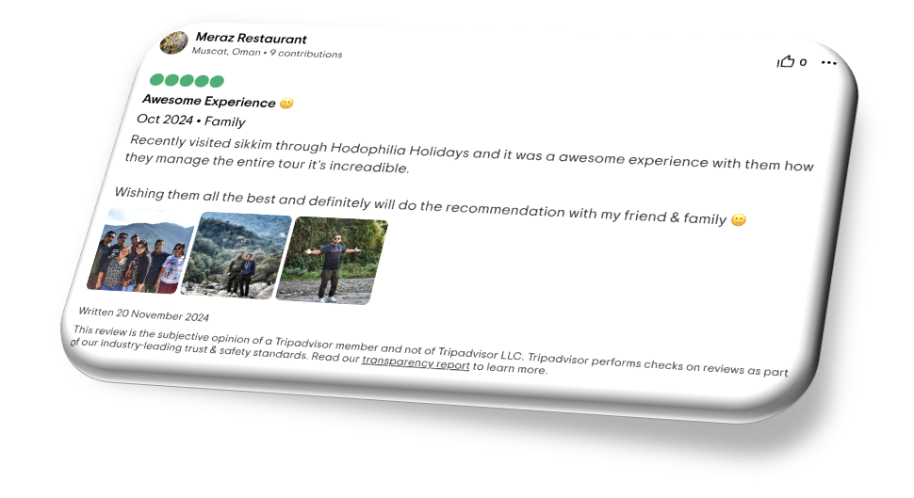
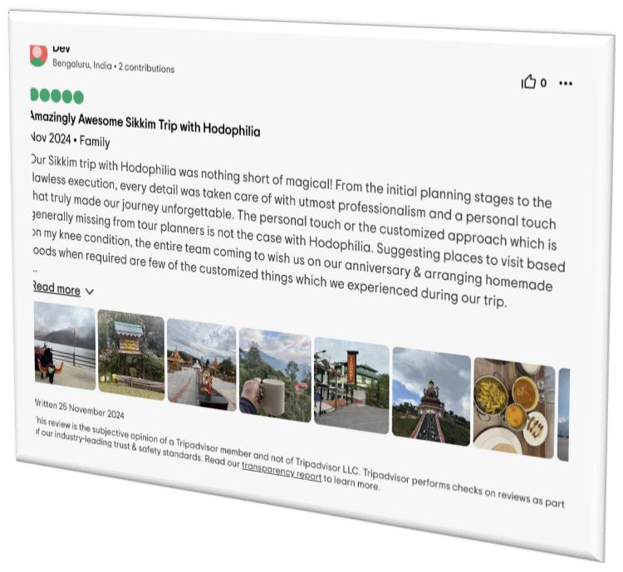
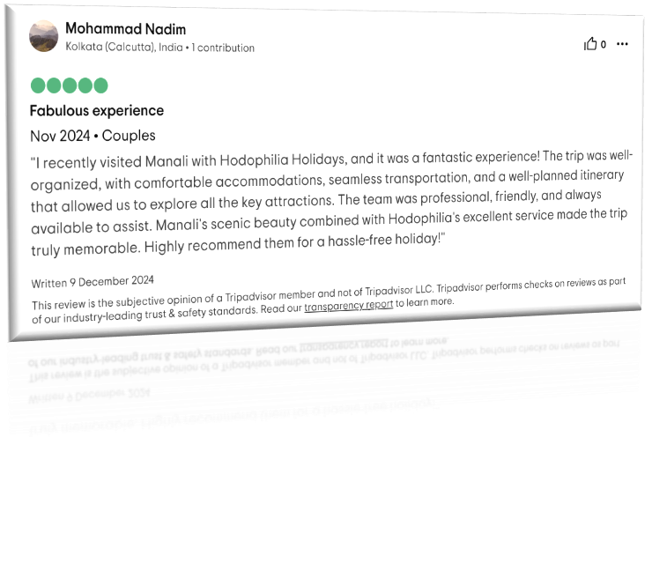

Slide 15
Contact Us
hodophiliaholidays@gmail.com
+91 6291570013
hodophiliaholidays.com
@hodophiliaholidays

