Slide 1




Slide 2
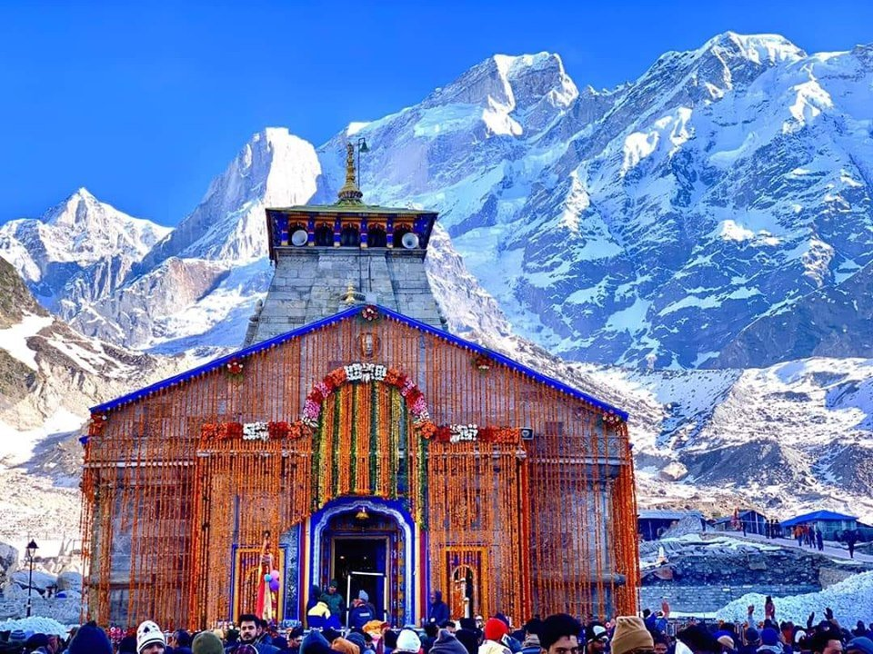
CHARDHAM YATRA
11 NIGHT 12 DAYS
EX: DELHI

Slide 3
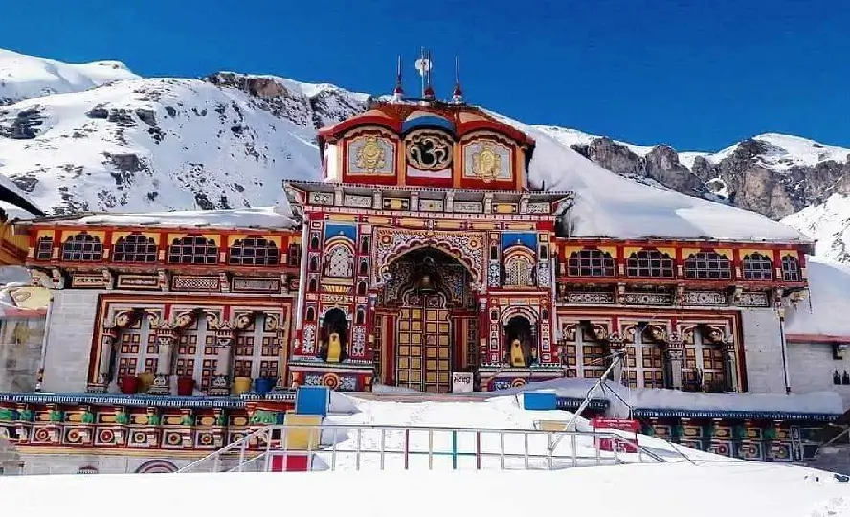

REQUIREMENT:
Char Dham Yatra (11N/12D)
Package Type | Group Package
Meal Plan | Breakfast + Dinner
No. of person | 5
Hotel Type | 3* - 4*
No. of Rooms | 2
Vehicle | TEMPO TRAVELLER
Start Date and Pickup Location | 20th MAY - DEHI
End Date and Drop Location | 31st MAY - DELHI

Slide 4
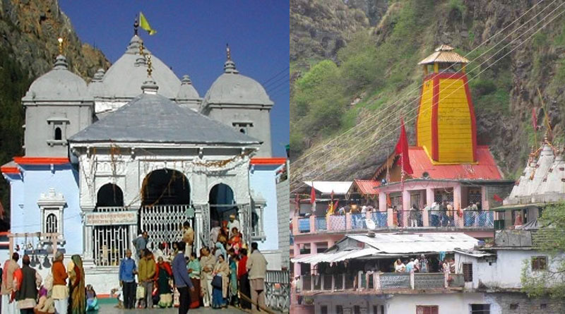
SHORT TOUR ITINERARY:
DAY 1: Delhi - Haridwar — Evening Ganga Aarti
DAY 2: Haridwar - Barkot — Enroute Mussoorie
DAY 3: Barkot - Yamunotri - Barkot — Yamunotri Temple Visit
DAY 4: Barkot - Uttarkashi —Temple Visit
DAY 5: Uttarkashi-Gangotri-Uttarkashi—GangotriTemple Visit
DAY 6: Uttarkashi to Guptkashi—Temple Visit
DAY 7: Guptkashi-Gaurikund-Kedarnath—KedarnathTemple Visit
DAY 8: Kedarnath-Gaurikund-Guptkashi
DAY 9: Guptkashi-Pipalkoti/ Joshimath
DAY 10: Pipalkoti/ Joshimath-BadrinathTemple -ManaVillage -Pipalkoti/ Joshimath
Day 11: Pipalkoti / Joshimath - Rishikesh — Adventure Activities DAY 12: Rishikesh - Haridwar — Delhi Drop

Slide 5
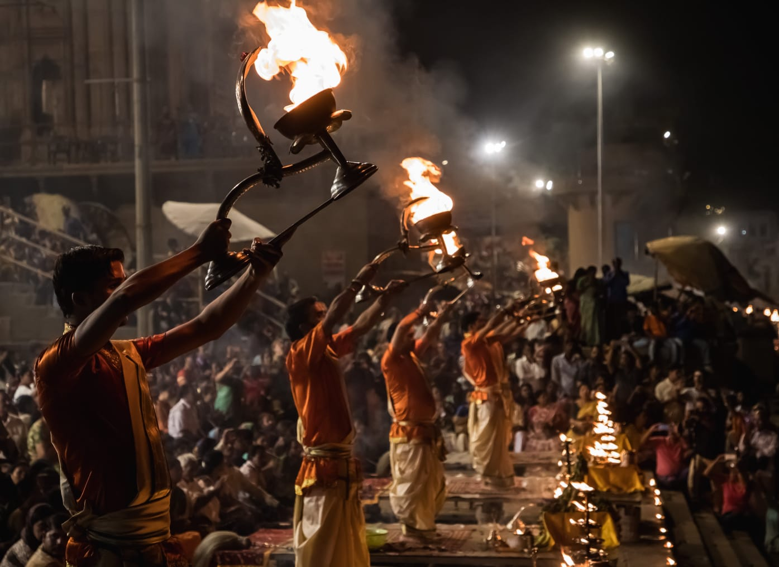
Day 1: Delhi - Haridwar — Evening Ganga Aarti
Pick up from your desired location within Delhi and proceed to visit Hardiwar (Hari ka Dwar, Gangadwar) upon arrival check-in in the hotel and after some rest proceed to visit- Shri Mata Mansa Devi Mandir, Chandi Devi Temple, Have a dip in the waters of river Ganga (believe its clean our soul) In the evening enchanting aarti in Har-Ki-Pauri, after an amazing religious Aarti return back to the hotel and relaxed a day in Haridwar hotel.

Slide 6
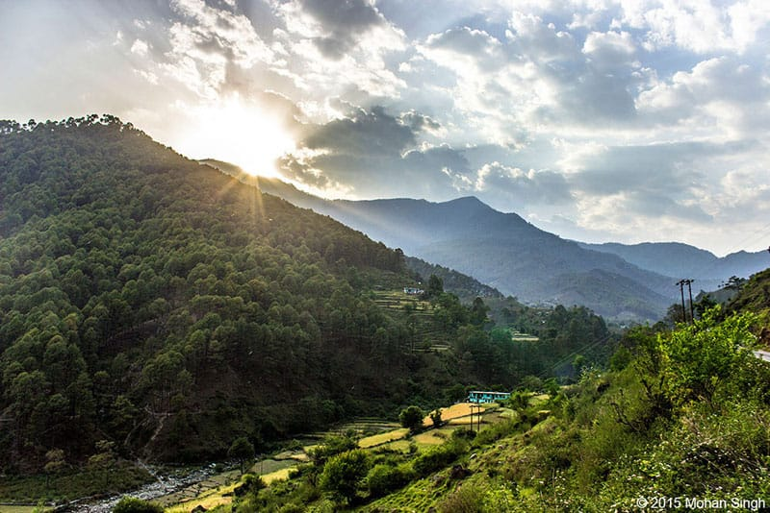
Day 2: Haridwar - Barkot — Enroute Mussoorie
Get picked up from the Haridwar Hotel and transfer to pre-booked hotel in Barkot in a comfortable vehicle. En route the Queen of Hills, a beautiful town surrounded by mountains. Once reached Barkot, Explore the small pilgrim town situated at the banks of the Yamuna river. Get transferred to the hotel & check-in.
Dinner at hotel and retire for the day. Make sure to have a good sleep to remove all stress and prepare for the next day.

Slide 7
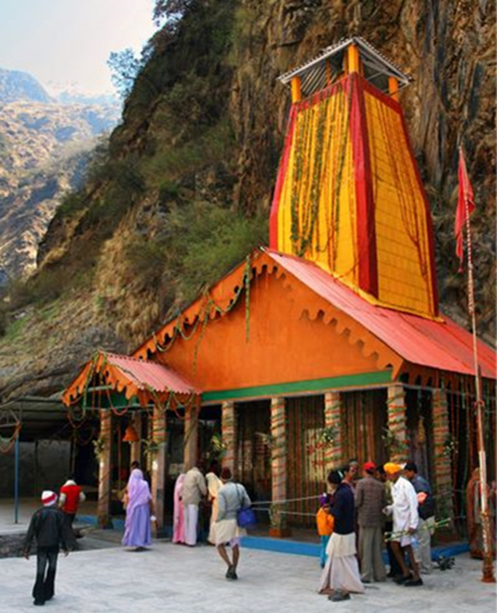
Day 3: Barkot - Yamunotri - Barkot — Yamunotri Temple Visit
Rise and get ready to be served with divinity as today is the first stop in the pilgrimage. Have Breakfast at Hotel to start the day. Drive to Yamunotri Dham the second most holy river of India from where the River Yamuna, takes birth. Reach Jan Ki Chatti the point from where the 6km trek starts. Before starting the trek take a bath in Jamnabai Kund's which is believed that the water cleanses all sins and protects from an untimely and painful death. Visit Surya Kund, a hot spring near the temple. Boil some rice and potatoes in the kund and accept it as a Prasad of the Devi. Trek down to Janki Chatti & later drive back to Barkot Hotel.Have Dinner at Hotel to end the day.Take a good sleep to gain energy for the further tour.

Slide 8
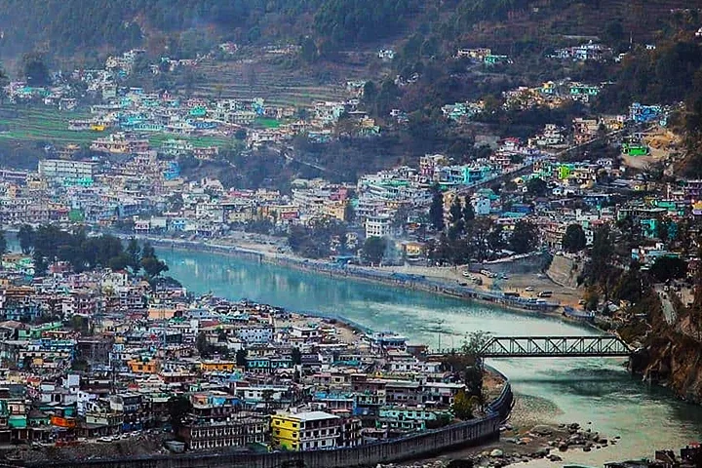
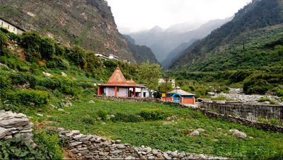
Day 4: Barkot to Uttarkashi — Temple Visit
Wake up in the land of spirituality. Get ready to move ahead from Barkot after breakfast. Today drove towards Uttarkashi, the holy town situated along the banks of river Bhagirathi and is one of the district capitals of Uttarakhand. On arrival check in to the hotel & freshen up for local sightseeing. Visit Vishwanath temple situated in the heart of the town. It is one of the oldest Shiva temples in Northern India. Reconstructed in 1857 by Maharani Khaneti Devi of Tehri State in the ancient architectural style. Followed by, Shakti Temple is famous for the big Trishul of about 6 meters in height and a circumference of 90 cm. As per the epics, this Shakti was thrown on the devils by the Goddess Durga.
Return to the hotel to have Dinner. Overnight at the Hotel

Slide 9
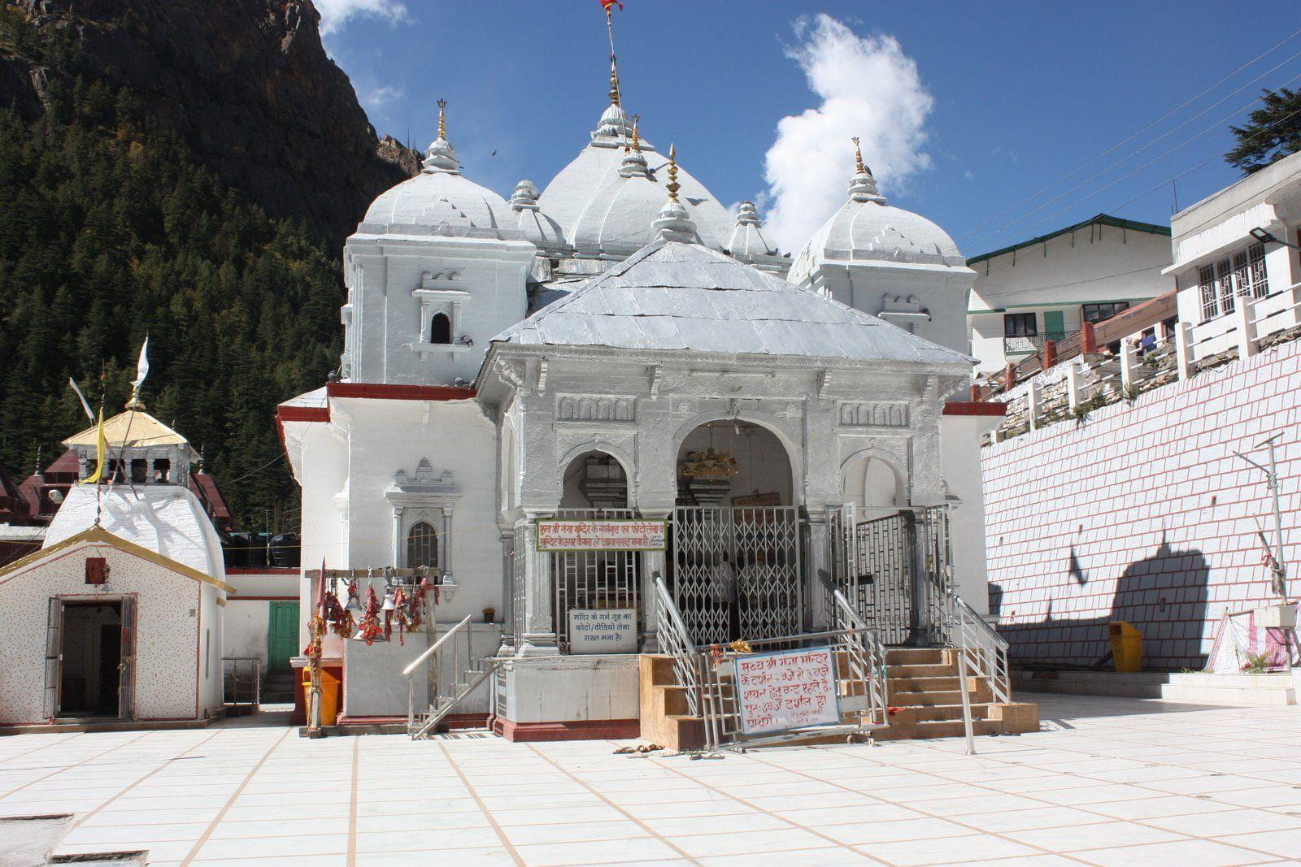
Day 5: Uttarkashi - Gangotri - Uttarkashi —
Gangotri Temple Visit
Wake up in between the mesmerizing mountains. Early morning after breakfast drive to Gangotri en route at Gangnani. Take a holy dip in Garam Kund at Gangnani. Drive further to Gangotri via the beautiful Harshil valley, famous for its natural beauty and the majestic views of the Deodar trees and mountains. On arrival at Shree Gangotri, take a holy dip in the sacred river Ganges which is also called Bhagirathi at its origin. On arrival at Gangotri Dham worship Goddess Ganga, who is said to have descended on earth to absolve the sins of humankind. After the Aarti soak the beauty of the place & relax while witnessing the greenery around. Later drive back to Uttarkashi.
Dinner at Hotel & Overnight stays at Uttarkashi.

Slide 10
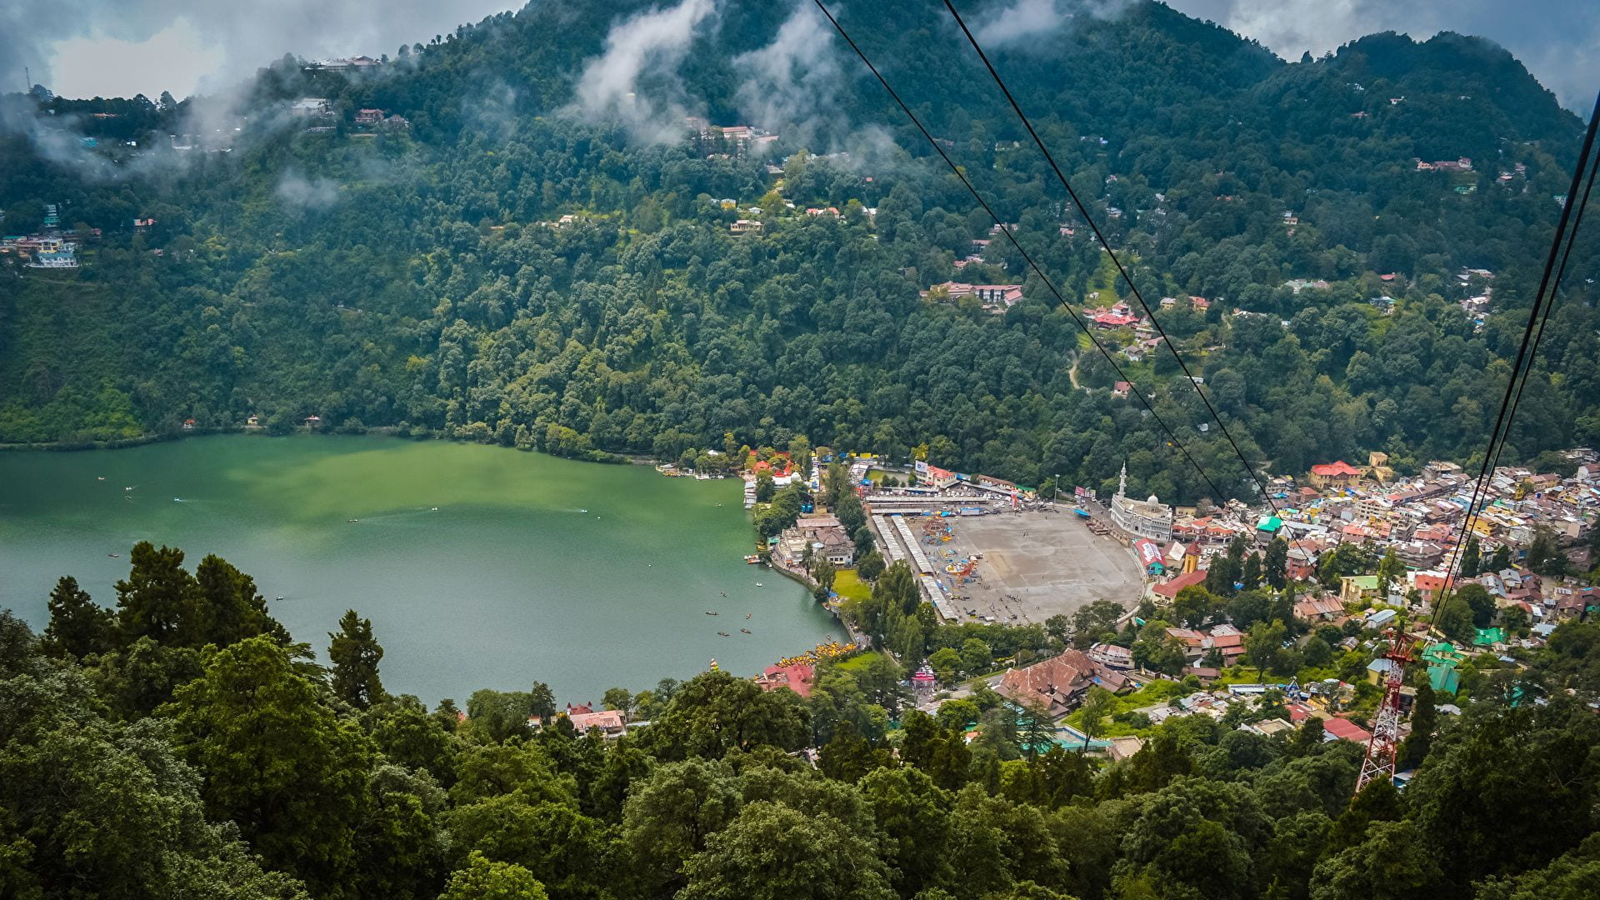
Day 6: Uttarkashi to Guptkashi — Temple
Visit
Wake up early and get transferred to Guptkashi after breakfast. Get a mesmerizing view of Ganga all across the journey. See the confluence of Alaknanda and Bhagirathi river at Devprayag. The lunch stop is at Srinagar (on your own)which is the best place in the Garhwal region. Afterward, there is no such facility to have food so make sure to keep all essentials from here only. Visit a view of Rudraprayag, Ukhimath in the journey. Once reached, Guptkashi gets transferred to the hotel. Visit ArdhNarishwar Temple (If time permits). If You go by trekking then your night stay will be in Sonprayag & for heli then your night stay will be nearby your helipad any of these respective location.
Dinner at the hotel and retire for the day.

Slide 11
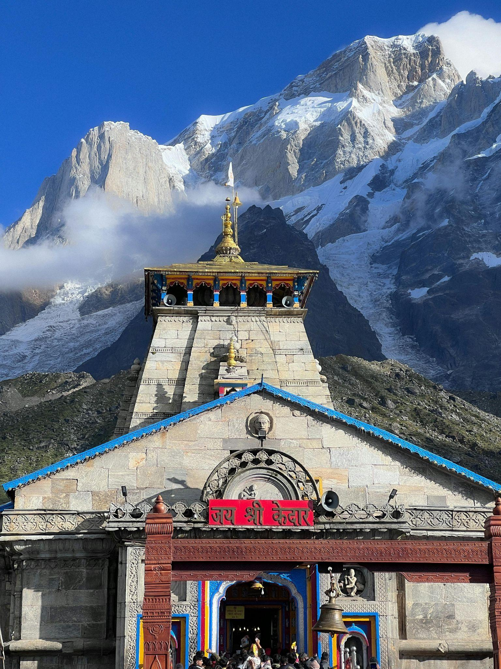
Day 7: Guptkashi - Kedarnath — Kedarnath Temple Visit
Wake up with the mesmerizing view of mountains all across. Have breakfast and start the Journey. One can take ponies or palanquins for the journey to make it slightly on a comfortable side. Have lunch stop in between at various food joints & maggie points. The journey will surely be worthwhile after reaching the Kedarnath Temple. On reaching the temple, praise the almighty Lord Shiva. This view will surely bring charm to the eyes. Indulged in evening aarti at Kedarnath, when the whole valley is filled with the sound of ringing bells and prayers going on everywhere which will provide relief to the soul.
After the temple visit, stay overnight in the hotel at Kedarnath .

Slide 12
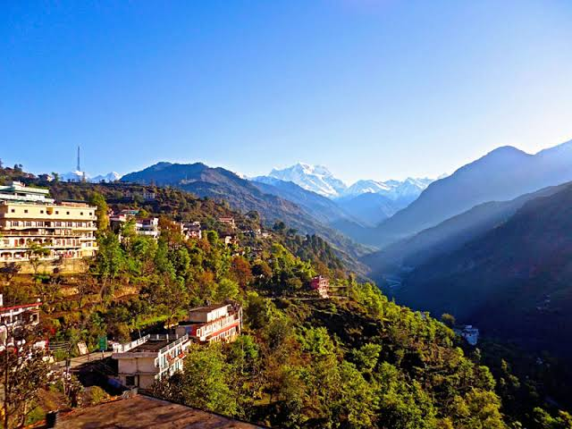
Day 8: Kedarnath - Guptkashi
Witness the morning beauty of the temple situated against the backdrop of the majestic Kedarnath range. Have breakfast afterward at your own and get ready to return to Guptkashi. Have lunch on the way only. Reach Guptkashi and douse into the magical water to diminish all the tiredness of the trek. Later on back to Guptkashi and checkin to the hotel and have your dinner.
Retire for the day.

Slide 13
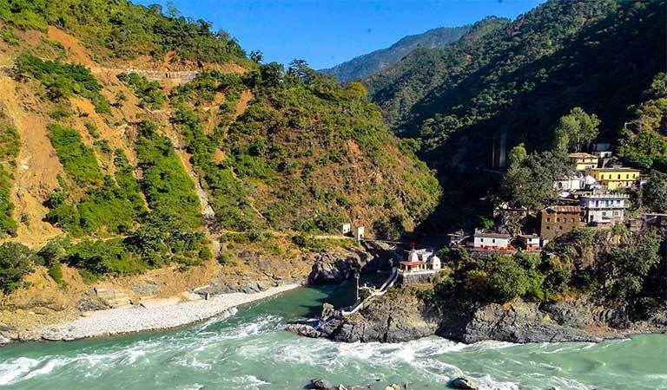
Day 9: Guptkashi to Pipalkoti / Joshimath
Wake up early in the morning and start the journey to Pipalkoti / Joshimath after breakfast. Get a mesmerizing view of Ganga all across the journey. On the way to Pipalkoti / Badrinath, Visit the Darshan of VishnuPrayag, Narsingh Temple in Joshimath, KarnPrayag and NandPrayag. Get transferred to the hotel & check-in. Dinner at the hotel and retire for the day. Make sure to have a good sleep to remove all stress and prepare for the next day.

Slide 14
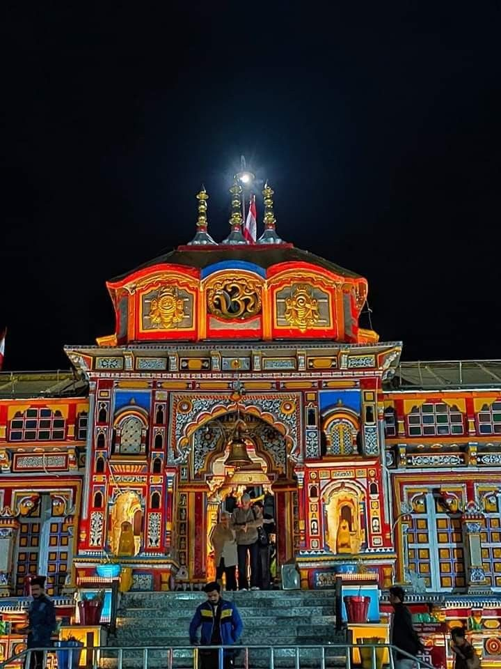
Day 10: Pipalkoti / Joshimath - Badrinath Temple - Mana Village - Pipalkoti / Joshimath
Wake up early in the morning in Pipalkoti / Badrinath, enjoy your breakfast and head off to Badrinath Temple. Pilgrims after having a bath in the Tapt Kund have the Darshan of Badrivishal & Aarti in evening. There are other interesting sightseeing spots like Mana Village, Vyas Gufa, Mata Murti, Charan Paduka, Bhimkund and the "Mukh of the Saraswati River”. Later on, back to Pipalkoti or Proceed to Rudraprayag for your next stay. Enjoy an overnight stay and dinner at the hotel in Pipalkoti / Joshimath.

Slide 15
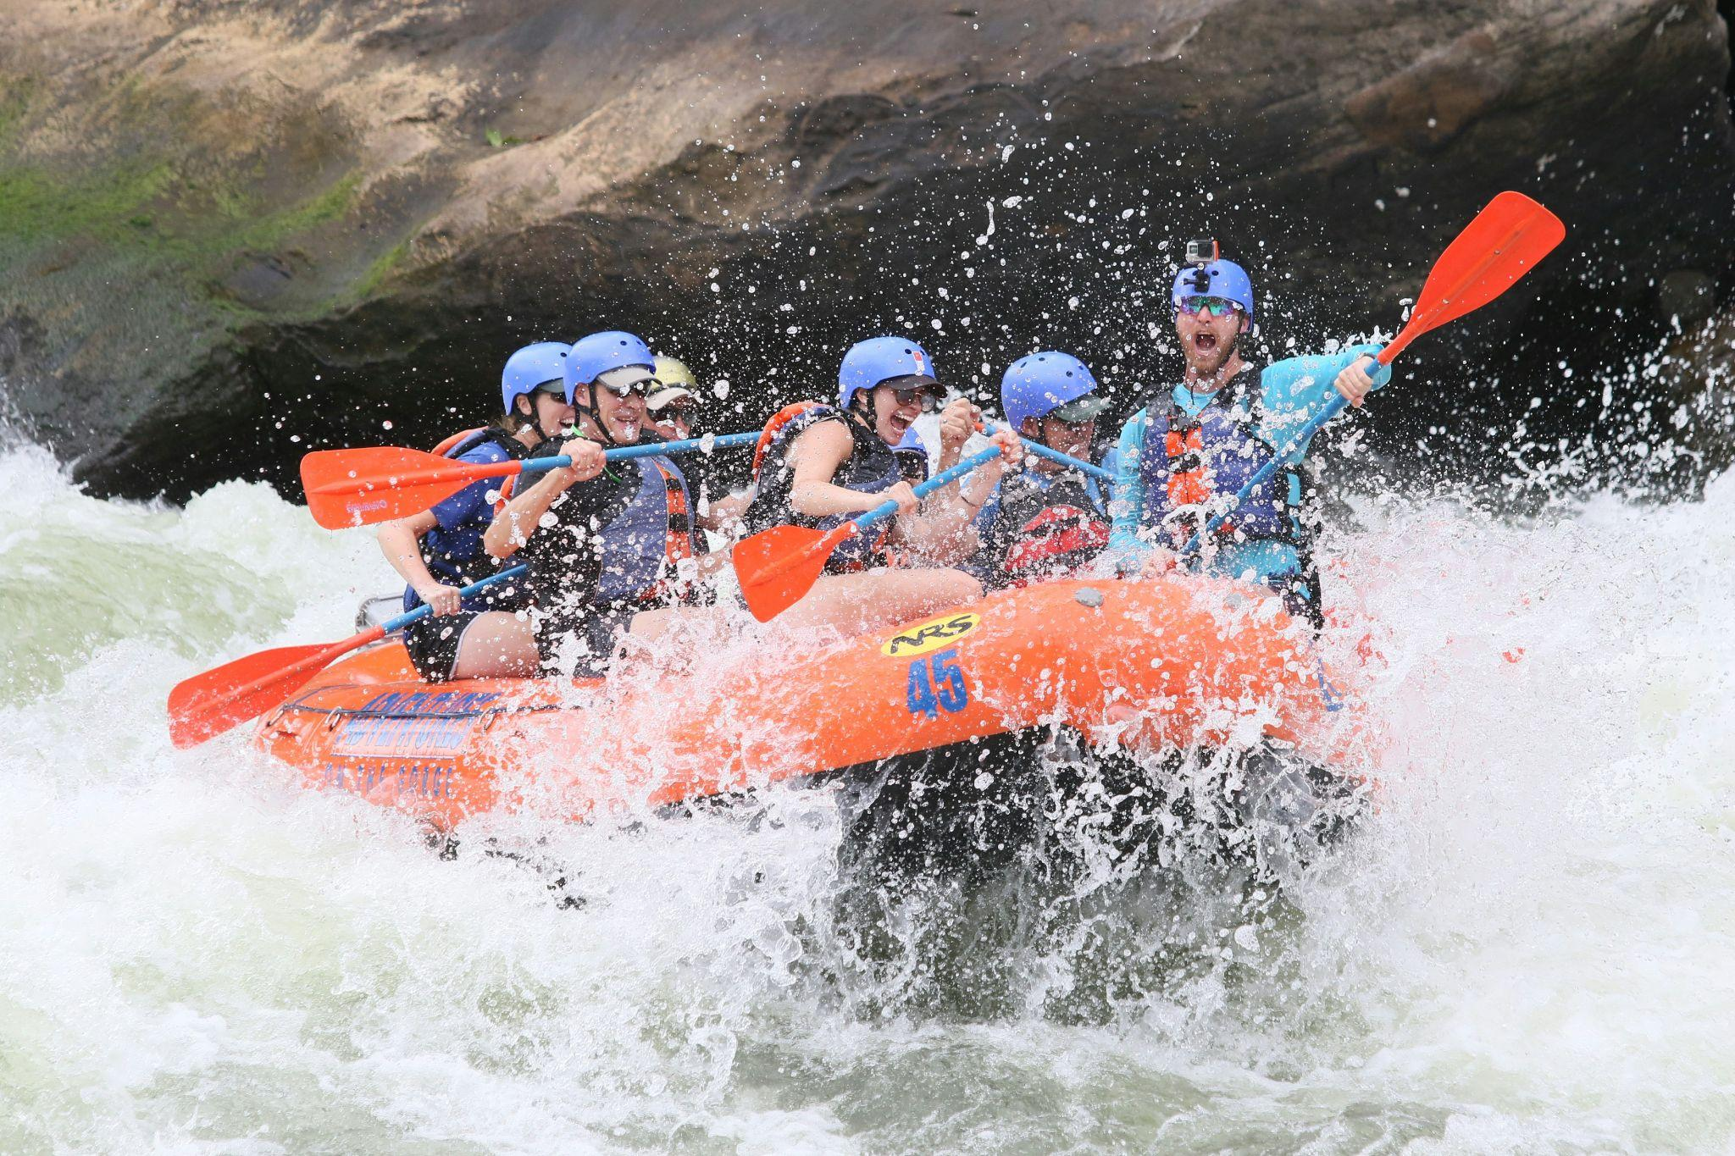
Day 11: Pipalkoti / Joshimath - Rishikesh — Adventure Activities
Wake up early in the morning, enjoy a wholesome breakfast in the hotel and start travelling to Rishikesh. Enjoy the activities such as Bungee Jumping and River Rafting in Shivpuri(By Own), which is known for its river rafting activity is 9 KMS away from Lakshman Jhula. In the evening, witness the Ganga aarti at Triveni Ghat.
Come back to the same hotel, freshen up and relax, enjoy an overnight stay and dinner at the hotel in Rishikesh..

Slide 16
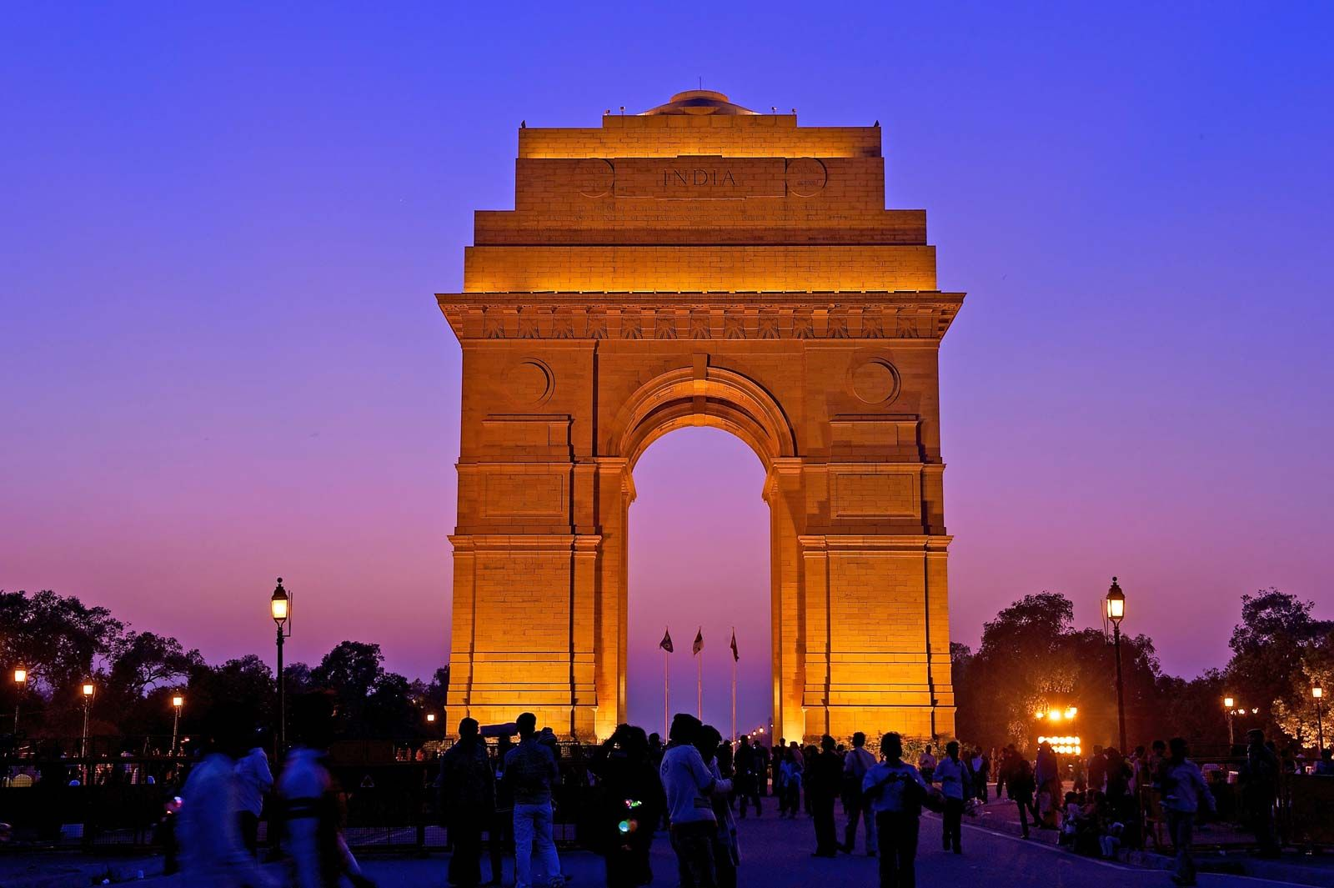
Day 12: Rishikesh - Haridwar — Delhi Drop
Wake up early in the morning and have breakfast and check out from the Hotel.
Then Drive to Delhi via Rishikesh & Haridwar.
Reach Delhi Railway Staion / Airpoet with total peace to the soul by taking blessings directly from God’s home.
End of trip with beautiful memories…

Slide 17





ACCOMODATIONS
DESTINATION | STANDARD | DELUXE HOTELS
HARIDWAR | NANDA RESIDENCY / SIMILAR | MY SPACE ARIHANT / SIMILAR
BARKOT | MOUNTAIN PARADISE / SIMILAR | NAMAMI GANGES / SIMILAR
UTTARKASHI | HOTEL NAGARAJ / SIMILAR | MAHIMA RESORT / SIMILAR
GUPTKLASHI | SHIV MANOHAR / SIMILAR | KEDAR VELLEY RESORT / SIMILAR
KEDARNATH | DOORMETRY | GMVN TENT / DOORMETRY
PIPALKOTI / JOSHIMATH | HOTEL GAJRAJ / SIMILAR | COMFORT INN / SIMILAR
RISHIKESH | HOTEL YOG TAPOVAN / SIMILAR | SHIVANSH INN RESORT / SIMILAR
PER PERSON COST | 24,999/- | 30,999/-
HELICOPTER CHARGES 10-12K EXTRA
CHILD BETWEEN 6-10 YEARS WILL CHARGES 50%
ESSENTIALS:
Basic personal items to be carried include, feather jacket & heavy woolens duringwinter and light woolens during summer, walking boots, rain proof jackets during monsoon, torch, spare batteries, water-flask, cold cream, personal medicines & Sunglasses. Guests are advised to bring heavy woolen clothes

Slide 18

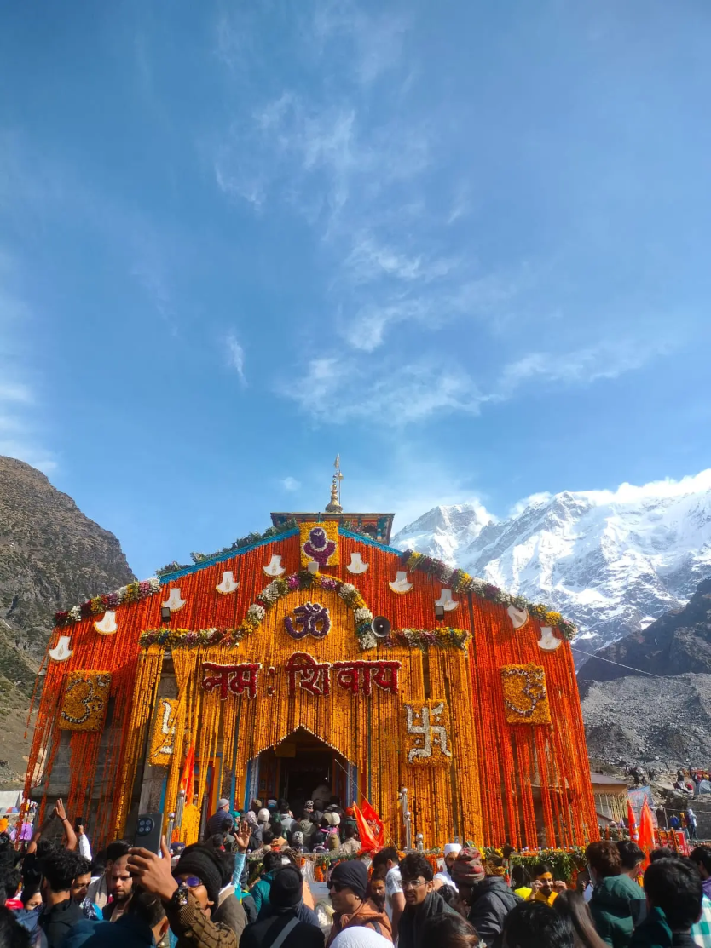
TERMS & CONDITIONS
INCLUSIONS:
Breakfast & Dinner
Pick Up drop
Sightseeing In Private
Hotel accommodation as per package same or similar hotels.
Registration.
Kedarnath stay in doormetry/ camp
No Food In Kedarnath.
All toll tax, parking, fuel and driver allowances.
EXCLUSIONS:
Air/Train Fare.
Personal Expenses such as laundry, telephone calls, tips & gratuity, mineral water,
soft & hard drinks, rafting, rock climbing, paragliding, joy ride (Toy Train), porterage.
Additional sightseeing or extra usage of vehicle, other than mentioned in the
Itinerary.
Entrance Fees & Guide charges.
Any cost arising due to the natural
calamities like, landslides, road blockages, political, disturbances (strikes), etc. (to be borne by the client, which is directly payable on the spot).
Any increase in taxes or fuel price, leading to the increase in cost on the surface transportation & land arrangements, which may come into effect prior to departure.
5% GST not included with this package
•

Slide 19
PAYMENT:
40% of the total package amount has to be done in advance to confirm the package. Bookings will not be processed without advance payment. Rest of the payment must be cleared at the time of arrival, either in our office or our representatives will be there at the NJP Rly Station/ Bagdogra Airport to collect the payment. Only cash/Demand draft drawn in the favor of HODOPHILIA.HOLIDAYS will be accepted. Cheques will not be acceptable. In case the payment is done through credit card 3% extra is chargeable. Kindly share your arrival details such as train /flight no etc. so that we can plan your schedule accordingly.
ABOUT TRANSPORT:
In this sector the same vehicles will not be provided for the entire tour, it will be changed sector-wise. So, we request you to avoid any circumstances. If any tourist spot is not covered which falls on closing day & if you want to do the same next day then you have to pay the extra cost for the vehicle. Kindly maintain the timing for the sightseeing’s / transfers which will be advisable by our executive.
PACKAGE POLICY:
The above itinerary is a suggested Tour Plan. The Company is responsible for only those services which are charged from the guest. All other services which are not paid by the guest to the Company are Suggested services and Company is nowhere bound to provide that service or pay the cost for the same. Check-in and Check-out timing of the Hotels will be according to the timing of the respective Hotels. Company is not responsible for compensating any loss or additional cost incurred by the guest while taking the tour. Company is not responsible nor liable for any damage, loss or injury caused to any passenger while taking the tour. Any Claim related to the Package must be brought to the notice of the Company within a week.
TERMS & CONDITIONS:
No refund will be made for any unused accommodation, missed meals, transportation segments, sightseeing tours or any other service. Such unused items are neither refundable nor exchangeable. Room allocation is done by the hotel depending upon the availability at the time of check-in in the category of room as specified on your confirmation voucher. No refund shall be claimed, if the services & amenities of hotels are not up to your expectations. Any cost arising due to the natural calamities like landslides, road blockage, political disturbances (strikes) etc. is to be borne by you which is directly payable on the spot.

Slide 20
AMENDMENT:
Amendment of the booked tour will be treated as Cancellation. However, minor amendments can be made on the payment of a communication charge, which will vary from case to case.
REFUND:
Refunds will be paid to the source through which the guest has booked. Any refund will take at least 15 days to process & will be sent to you by A/c Payee Cheque only.
** NO REFUND WILL BE MADE AGAINST ANY UNUTILIZED SERVICES, WHAT SO EVER MAY BE THE REASONS.
CANCELLATION POLICY:
Cancellation has to be sent to us by Mail/Fax.
From The Date of Booking: 40% Of Tour Cost Will Be Charged as Cancellation Fees.
30-15 Days Prior To Departure: 60% Of Tour Cost Will Be Charged as Cancellation Fees. 14-01 Days
Prior To Departure: 100% Of Tour Cost Will Be Charged as Cancellation Fees.
In case of any unforeseen weather conditions or government restrictions, Covid restrictions may
be cancelled and in such cases, the operator will try his best to provide an alternate feasible activity. However, no refund will be provided for the same.
Above are the cancellation rules but we will put our best possible efforts to minimize the cancellation charges.

Slide 21






WHY HODOPHILIA HOLIDAYS ?
BEST SERVICE AT COMPETITIVE VALUE
Hodophilia Holidays delivers 98% trip success with rates 10% below market, backed by 99.5% booking accuracy and 15-minute emergency response.
CUSTOMIZED TO YOUR SATISFACTION
Crafting personalized journeys with 95% pre-trip checklist completion, we achieve customer satisfaction scores of 4.5/5 across all travel experiences.
TRIP MEMORY TO CHERISH
Creating lifelong memories with our 4.3/5 real-time satisfaction rating and 70+ Net Promoter Score for extraordinary travel experiences.
TRUSTED BY TRAVELLERS
Trusted by travelers: 50% of our business comes from referrals, matched by our 40% repeat booking success

Slide 22

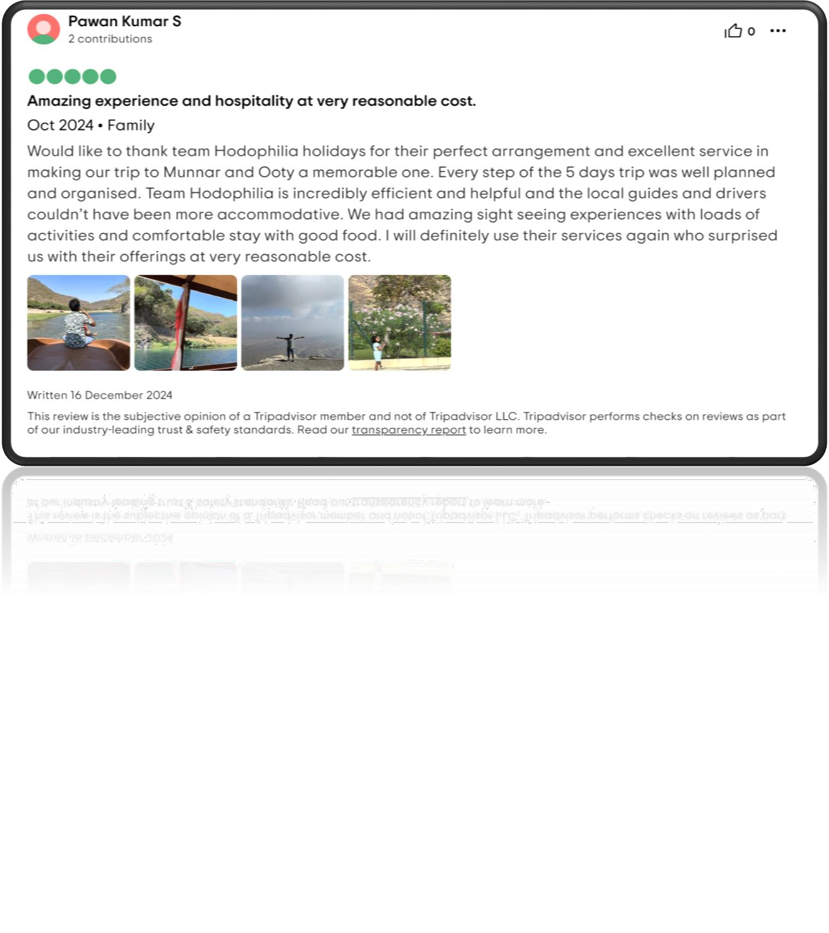
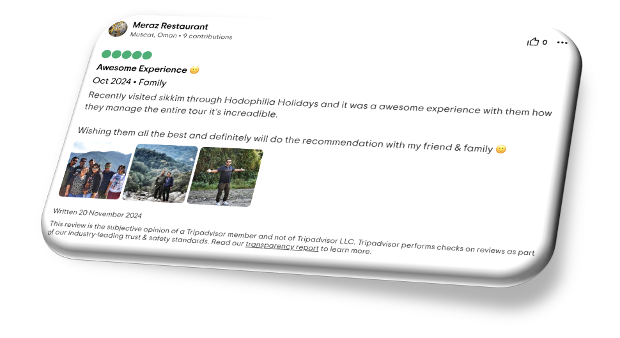
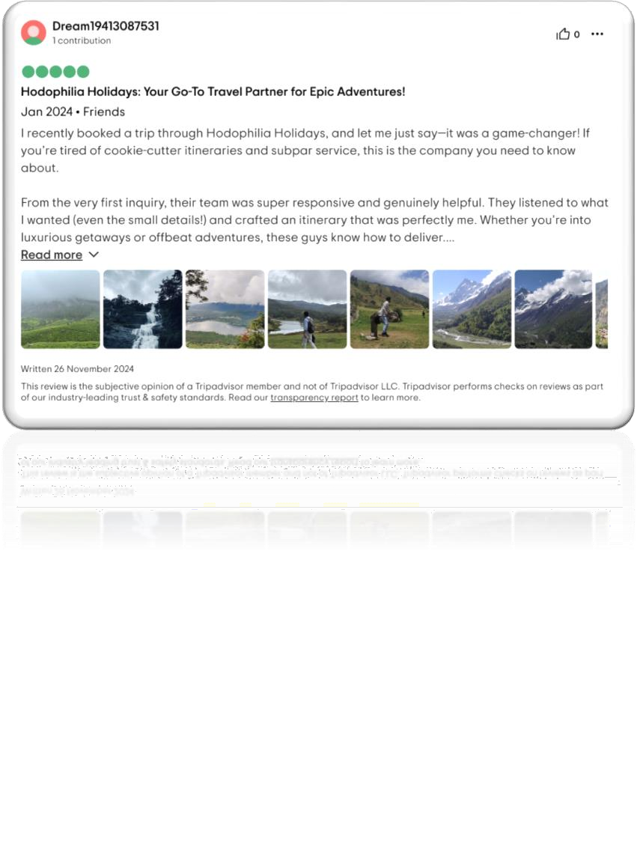
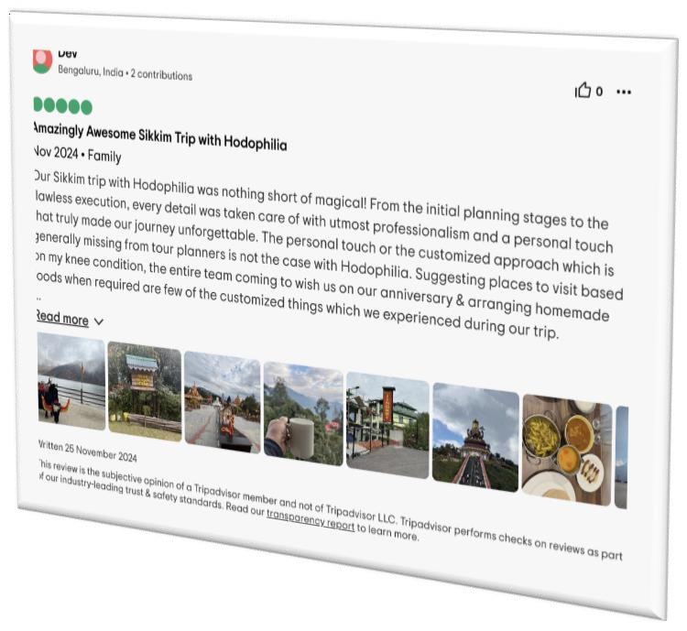
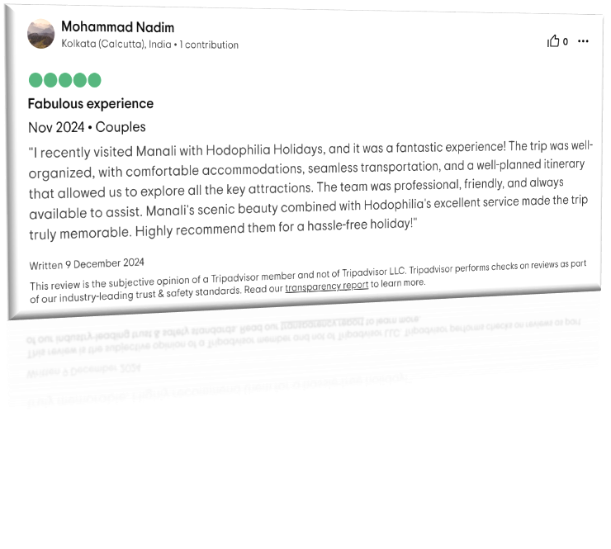


Slide 23




Contact Us
hodophiliaholidays@gmail.com
+91 6291570013
hodophiliaholidays.com
@hodophiliaholidays

