Slide 2
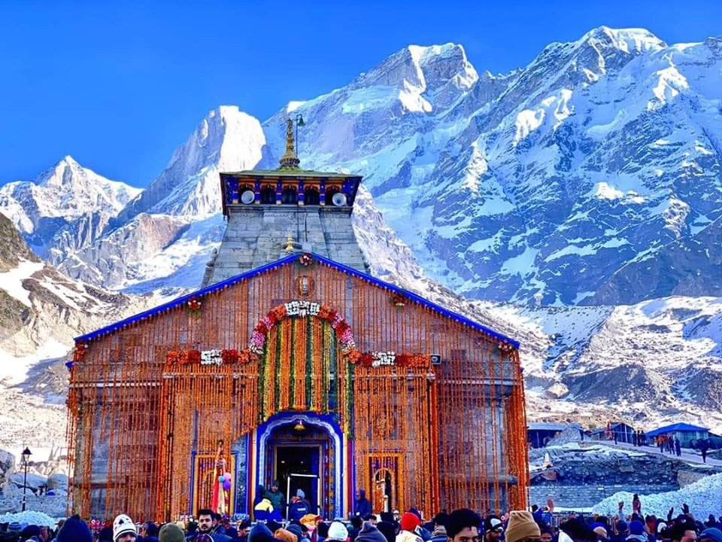
EK DHAM YATRA
3 NIGHT 4 DAYS
EX: HARIDWAR

Slide 3
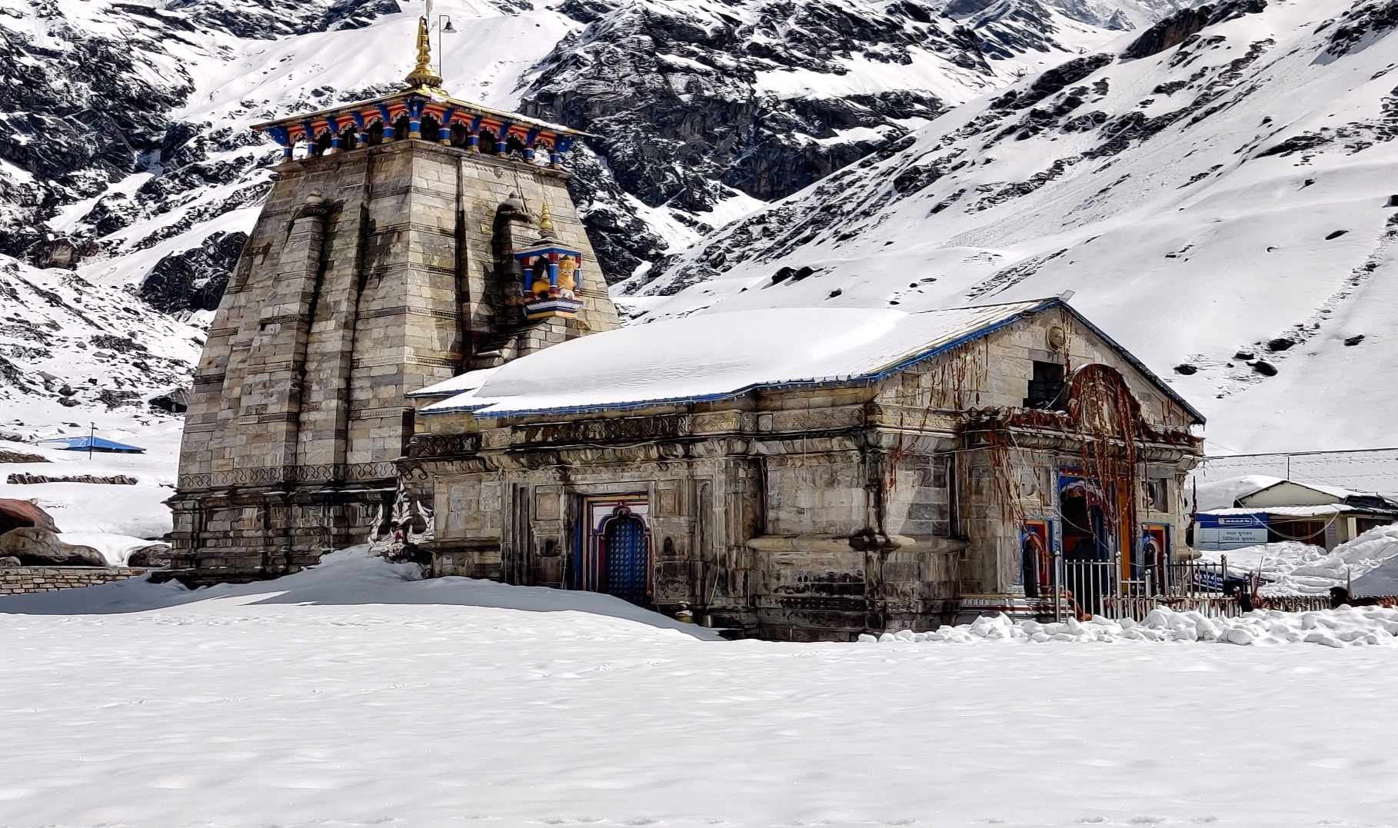
REQUIREMENT:
Ek Dham Yatra (3N/4D)
Package Type | Private Package
Meal Plan | Breakfast + Dinner
No. of person | 4
Hotel Type | 3* - 4*
No. of Rooms | 1/2
Vehicle | SEDAN
Start Date and Pickup Location | MAY -DEHI
End Date and Drop Location | MAY -DELHI

Slide 4
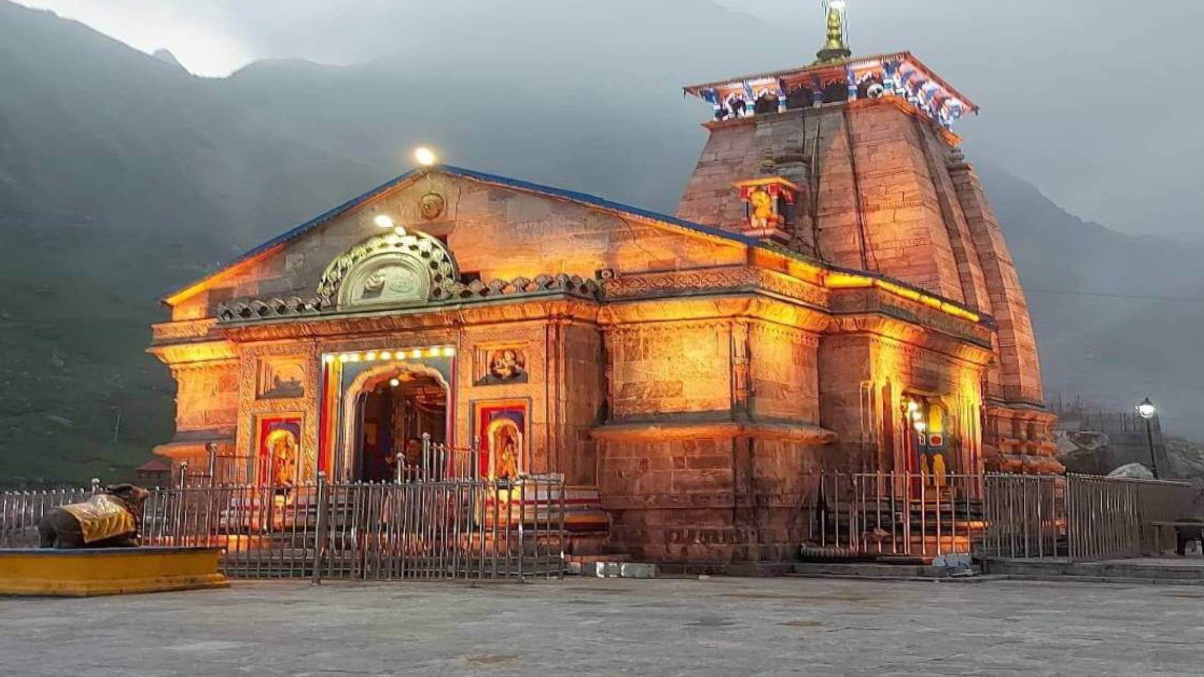
SHORT TOUR ITINERARY:
DAY 1: Haridwar to Guptkashi—Temple Visit
DAY 2: Guptkashi-Gaurikund-Kedarnath—KedarnathTemple Visit
DAY 3: Kedarnath-Gaurikund-Guptkashi
DAY 4: Guptkashi- - Rishikesh — Adventure Activities — Haridwar Drop

Slide 5
Day 1: Haridwar to Guptkashi — Temple Visit
Meet our representative at a pickup point in Haridwar Railway Station and get transferred to your pre-booked hotel in Guptkashi. Get a mesmerizing view of Ganga all across the journey. See the confluence of Alaknanda and Bhagirathi river at Devprayag. The stop in between is at Srinagar which is the best place in the Garhwal region, afterwards there is no such facility to have food so make sure you keep all essentials from here only. Get a view of Rudraprayag, Ukhimath in the journey. Once reach Guptkashi get transferred to your hotel. Visit ArdhNarishwar Temple (If time permits). Dinner at hotel and retire for the day. Make sure to have a good sleep to remove all stress and prepare for the next day.

Slide 6
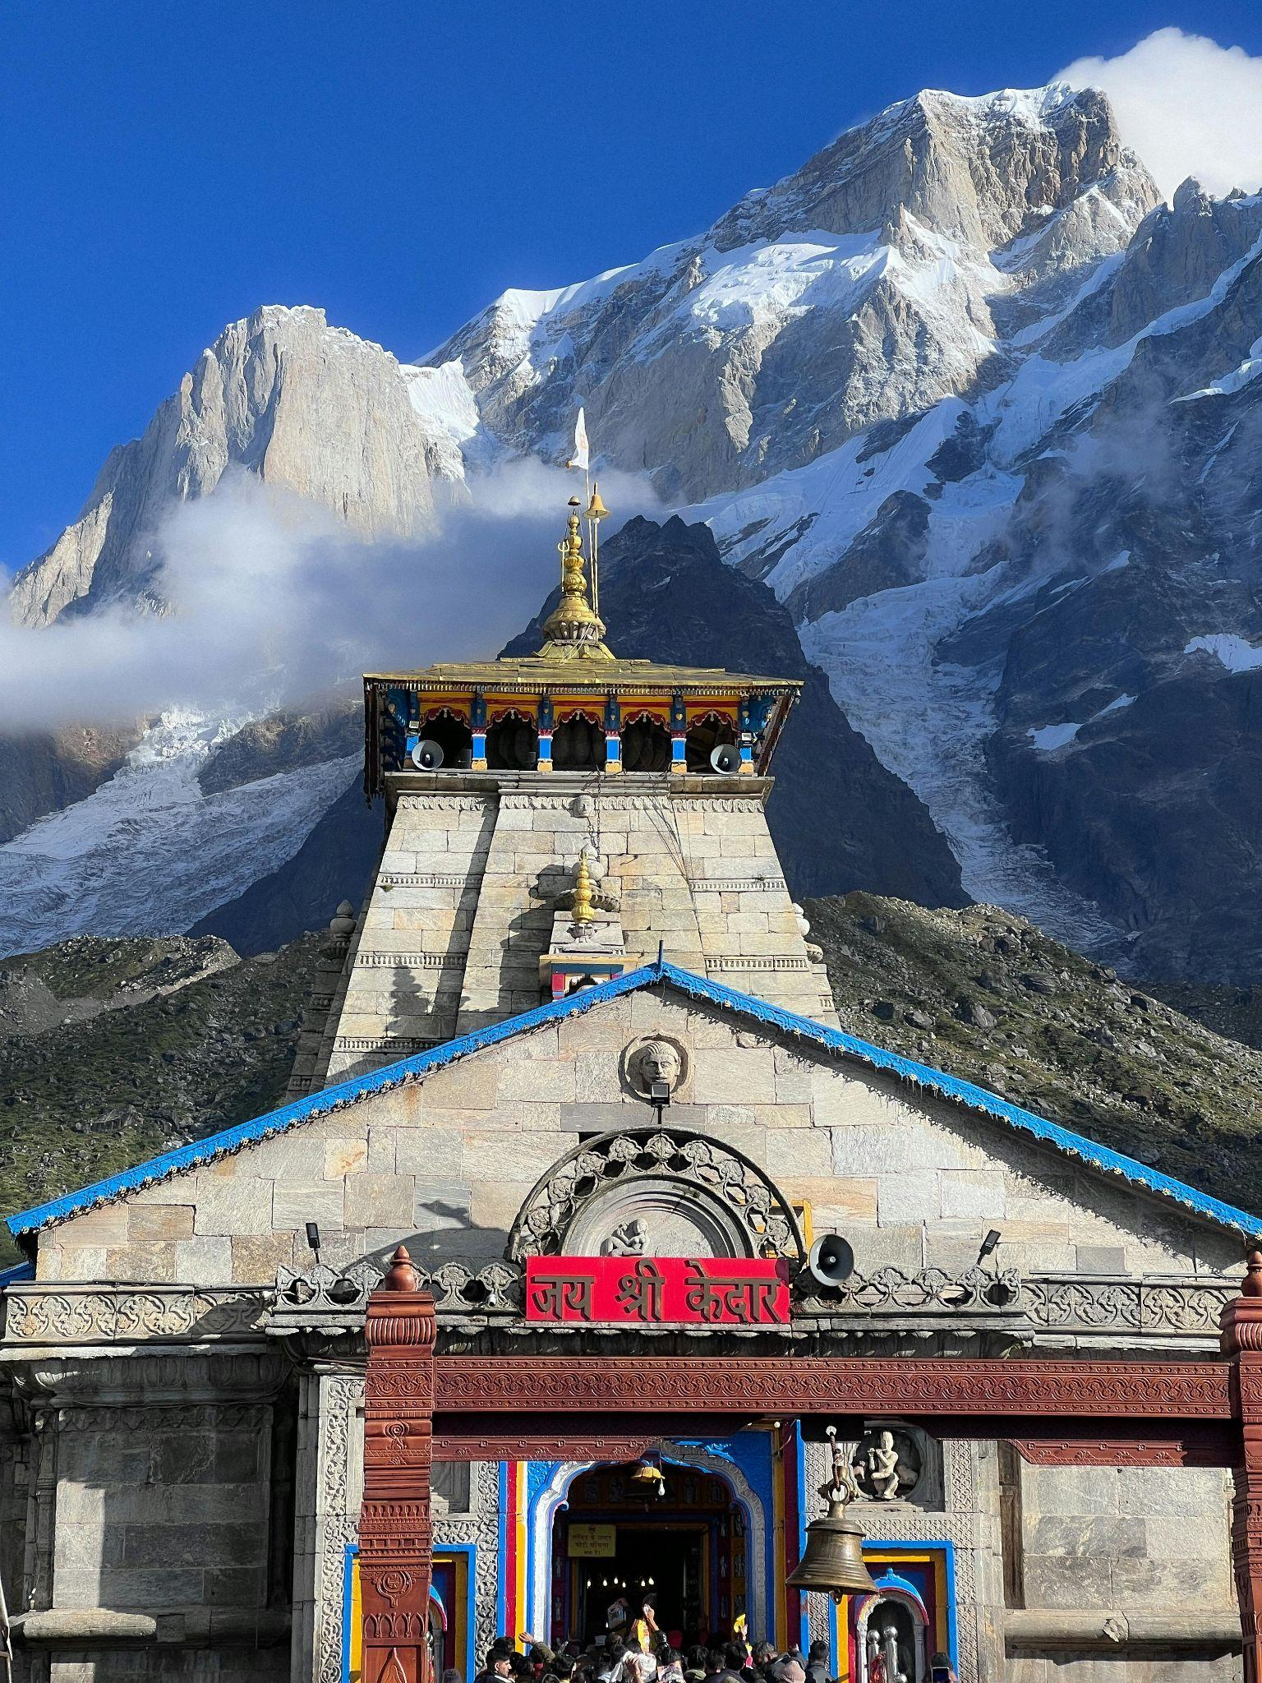
Day 2: Guptkashi - Kedarnath — Kedarnath Temple Visit
Wake up with the mesmerizing view of mountains all across. Have breakfast and start the Journey. One can take ponies or palanquins for the journey to make it slightly on a comfortable side. Have lunch stop in between at various food joints & maggie points. The journey will surely be worthwhile after reaching the Kedarnath Temple. On reaching the temple, praise the almighty Lord Shiva. This view will surely bring charm to the eyes. Indulged in evening aarti at Kedarnath, when the whole valley is filled with the sound of ringing bells and prayers going on everywhere which will provide relief to the soul.
After the temple visit, stay overnight in the hotel at Kedarnath .

Slide 7
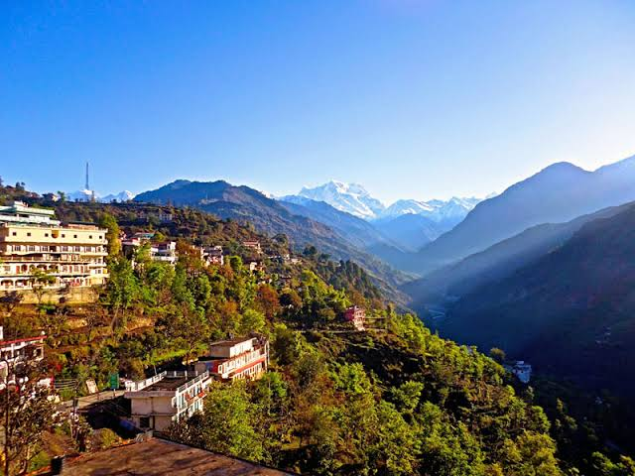
Day 3: Kedarnath - Guptkashi
Witness the morning beauty of the temple situated against the backdrop of the majestic Kedarnath range. Have breakfast afterward at your own and get ready to return to Guptkashi. Have lunch on the way only. Reach Guptkashi and douse into the magical water to diminish all the tiredness of the trek. Later on back to Guptkashi and checkin to the hotel and have your dinner.
Retire for the day.

Slide 8
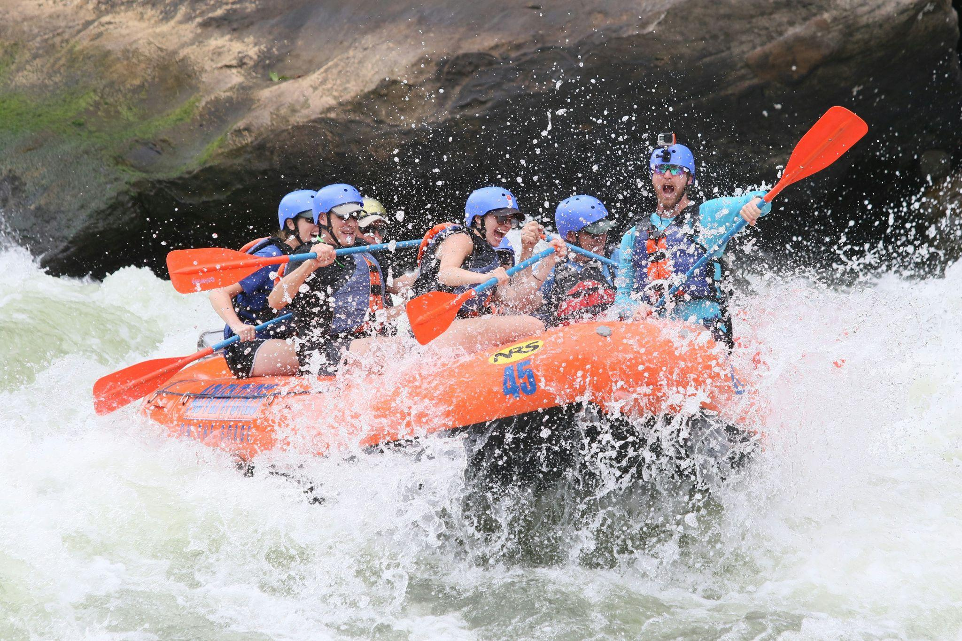
Day 4: Guptkashi - Rishikesh — Adventure Activities — Haridwar Drop
Wake up early in the morning, enjoy a wholesome breakfast in the hotel and start travelling to Rishikesh. Enjoy the activities such as Bungee Jumping and River Rafting in Shivpuri(By Own), which is known for its river rafting activity is 9 KMS away from Lakshman Jhula. In the evening, witness the Ganga aarti at Triveni Ghat.
Reach Haridwar with total peace to the soul by taking blessings directly from God’s home.
End of trip with beautiful memories

Slide 9
ACCOMODATIONS
DESTINATION | STANDARD | DELUXE HOTELS
GUPTKASHI | SHIV MANOHAR / SIMILAR | KEDAR VELLEY RESORT / SIMILAR
KEDARNATH | DOORMETRY | GMVN TENT / DOORMETRY
PER PERSON COST | 7,499/- | 10,999/-
HELICOPTER CHARGES 10-12K EXTRA
CHILD BETWEEN 6-10 YEARS WILL CHARGES 50%
ESSENTIALS:
Basic personal items to be carried include, feather jacket & heavy woolens duringwinter and light woolens during summer, walking boots, rain proof jackets during monsoon, torch, spare batteries, water-flask, cold cream, personal medicines & Sunglasses. Guests are advised to bring heavy woolen clothes

Slide 10
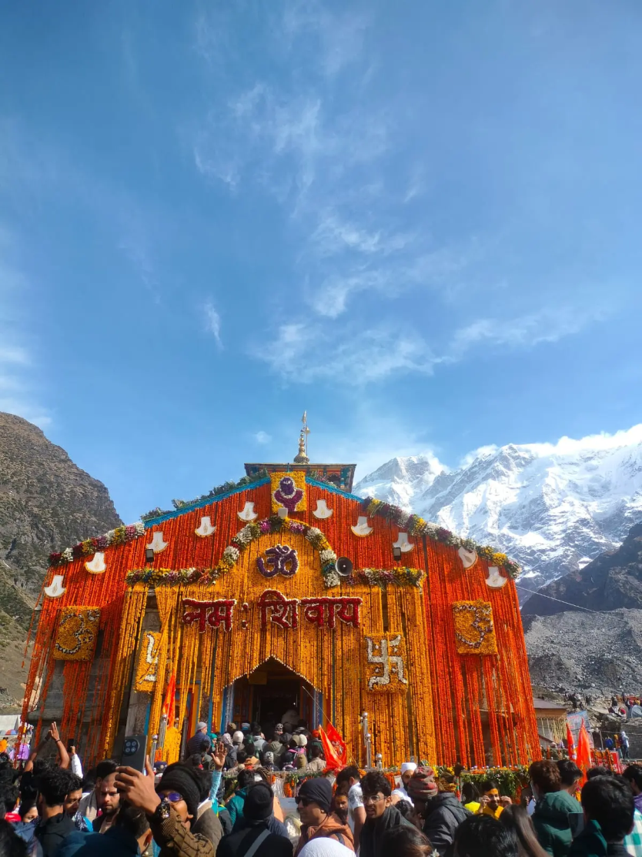
TERMS & CONDITIONS
INCLUSIONS:
Breakfast & Dinner
Pick Up drop
Sightseeing In Private
Hotel accommodation as per package same or similar hotels.
Registration.
Kedarnath stay in doormetry/ camp.
No Food In Kedarnath.
All toll tax, parking, fuel and driver allowances.
EXCLUSIONS:
Air/Train Fare.
Personal Expenses such as laundry, telephone calls, tips & gratuity, mineral water,
soft & hard drinks, rafting, rock climbing, paragliding, joy ride (Toy Train), porterage.
Additional sightseeing or extra usage of vehicle, other than mentioned in the
Itinerary.
Entrance Fees & Guide charges.
Any cost arising due to the natural
calamities like, landslides, road blockages, political, disturbances (strikes), etc. (to be borne by the client, which is directly payable on the spot).
Any increase in taxes or fuel price, leading to the increase in cost on the surface transportation & land arrangements, which may come into effect prior to departure.
5% GST not included with this package
•

Slide 11
PAYMENT:
40% of the total package amount has to be done in advance to confirm the package. Bookings will not be processed without advance payment. Rest of the payment must be cleared at the time of arrival, either in our office or our representatives will be there at the NJP Rly Station/ Bagdogra Airport to collect the payment. Only cash/Demand draft drawn in the favor of HODOPHILIA.HOLIDAYS will be accepted. Cheques will not be acceptable. In case the payment is done through credit card 3% extra is chargeable. Kindly share your arrival details such as train /flight no etc. so that we can plan your schedule accordingly.
ABOUT TRANSPORT:
In this sector the same vehicles will not be provided for the entire tour, it will be changed sector-wise. So, we request you to avoid any circumstances. If any tourist spot is not covered which falls on closing day & if you want to do the same next day then you have to pay the extra cost for the vehicle. Kindly maintain the timing for the sightseeing’s / transfers which will be advisable by our executive.
PACKAGE POLICY:
The above itinerary is a suggested Tour Plan. The Company is responsible for only those services which are charged from the guest. All other services which are not paid by the guest to the Company are Suggested services and Company is nowhere bound to provide that service or pay the cost for the same. Check-in and Check-out timing of the Hotels will be according to the timing of the respective Hotels. Company is not responsible for compensating any loss or additional cost incurred by the guest while taking the tour. Company is not responsible nor liable for any damage, loss or injury caused to any passenger while taking the tour. Any Claim related to the Package must be brought to the notice of the Company within a week.
TERMS & CONDITIONS:
No refund will be made for any unused accommodation, missed meals, transportation segments, sightseeing tours or any other service. Such unused items are neither refundable nor exchangeable. Room allocation is done by the hotel depending upon the availability at the time of check-in in the category of room as specified on your confirmation voucher. No refund shall be claimed, if the services & amenities of hotels are not up to your expectations. Any cost arising due to the natural calamities like landslides, road blockage, political disturbances (strikes) etc. is to be borne by you which is directly payable on the spot.

Slide 12
AMENDMENT:
Amendment of the booked tour will be treated as Cancellation. However, minor amendments can be made on the payment of a communication charge, which will vary from case to case.
REFUND:
Refunds will be paid to the source through which the guest has booked. Any refund will take at least 15 days to process & will be sent to you by A/c Payee Cheque only.
** NO REFUND WILL BE MADE AGAINST ANY UNUTILIZED SERVICES, WHAT SO EVER MAY BE THE REASONS.
CANCELLATION POLICY:
Cancellation has to be sent to us by Mail/Fax.
From The Date of Booking: 40% Of Tour Cost Will Be Charged as Cancellation Fees.
30-15 Days Prior To Departure: 60% Of Tour Cost Will Be Charged as Cancellation Fees. 14-01 Days
Prior To Departure: 100% Of Tour Cost Will Be Charged as Cancellation Fees.
In case of any unforeseen weather conditions or government restrictions, Covid restrictions may
be cancelled and in such cases, the operator will try his best to provide an alternate feasible activity. However, no refund will be provided for the same.
Above are the cancellation rules but we will put our best possible efforts to minimize the cancellation charges.

Slide 13
WHY HODOPHILIA HOLIDAYS ?
BEST SERVICE AT COMPETITIVE VALUE
Hodophilia Holidays delivers 98% trip success with rates 10% below market, backed by 99.5% booking accuracy and 15-minute emergency response.
CUSTOMIZED TO YOUR SATISFACTION
Crafting personalized journeys with 95% pre-trip checklist completion, we achieve customer satisfaction scores of 4.5/5 across all travel experiences.
TRIP MEMORY TO CHERISH
Creating lifelong memories with our 4.3/5 real-time satisfaction rating and 70+ Net Promoter Score for extraordinary travel experiences.
TRUSTED BY TRAVELLERS
Trusted by travelers: 50% of our business comes from referrals, matched by our 40% repeat booking success

Slide 14
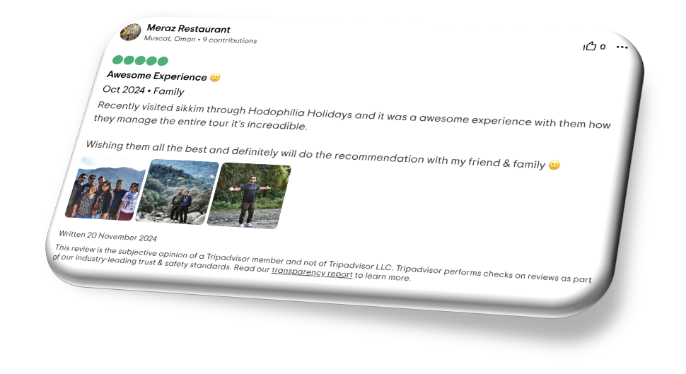
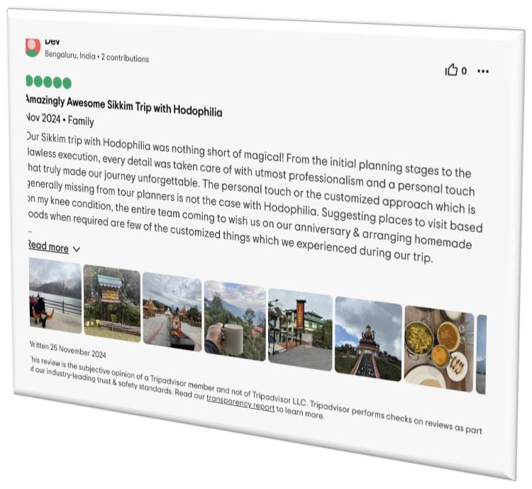
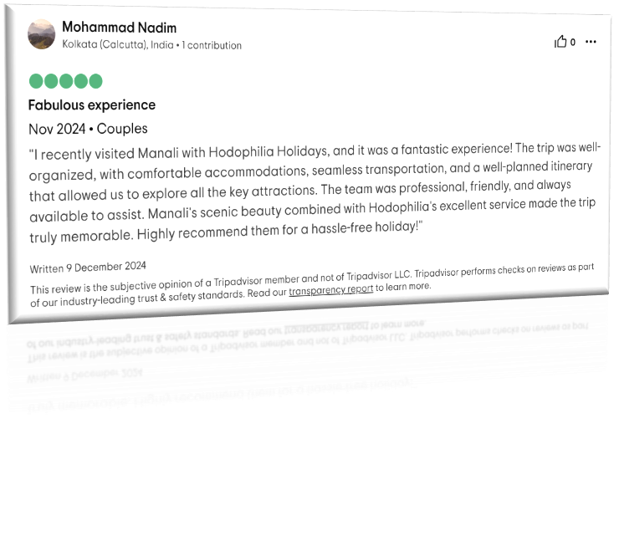

Slide 15
Contact Us
hodophiliaholidays@gmail.com
+91 6291570013
hodophiliaholidays.com
@hodophiliaholidays

